Slide 1
Improving Water Quality in the Red River & Ouachita Basins September 2011-September 2012
Olivia Ward
Watershed Coordinator
Trailblazer RC&D
Ruston, La

Slide 2
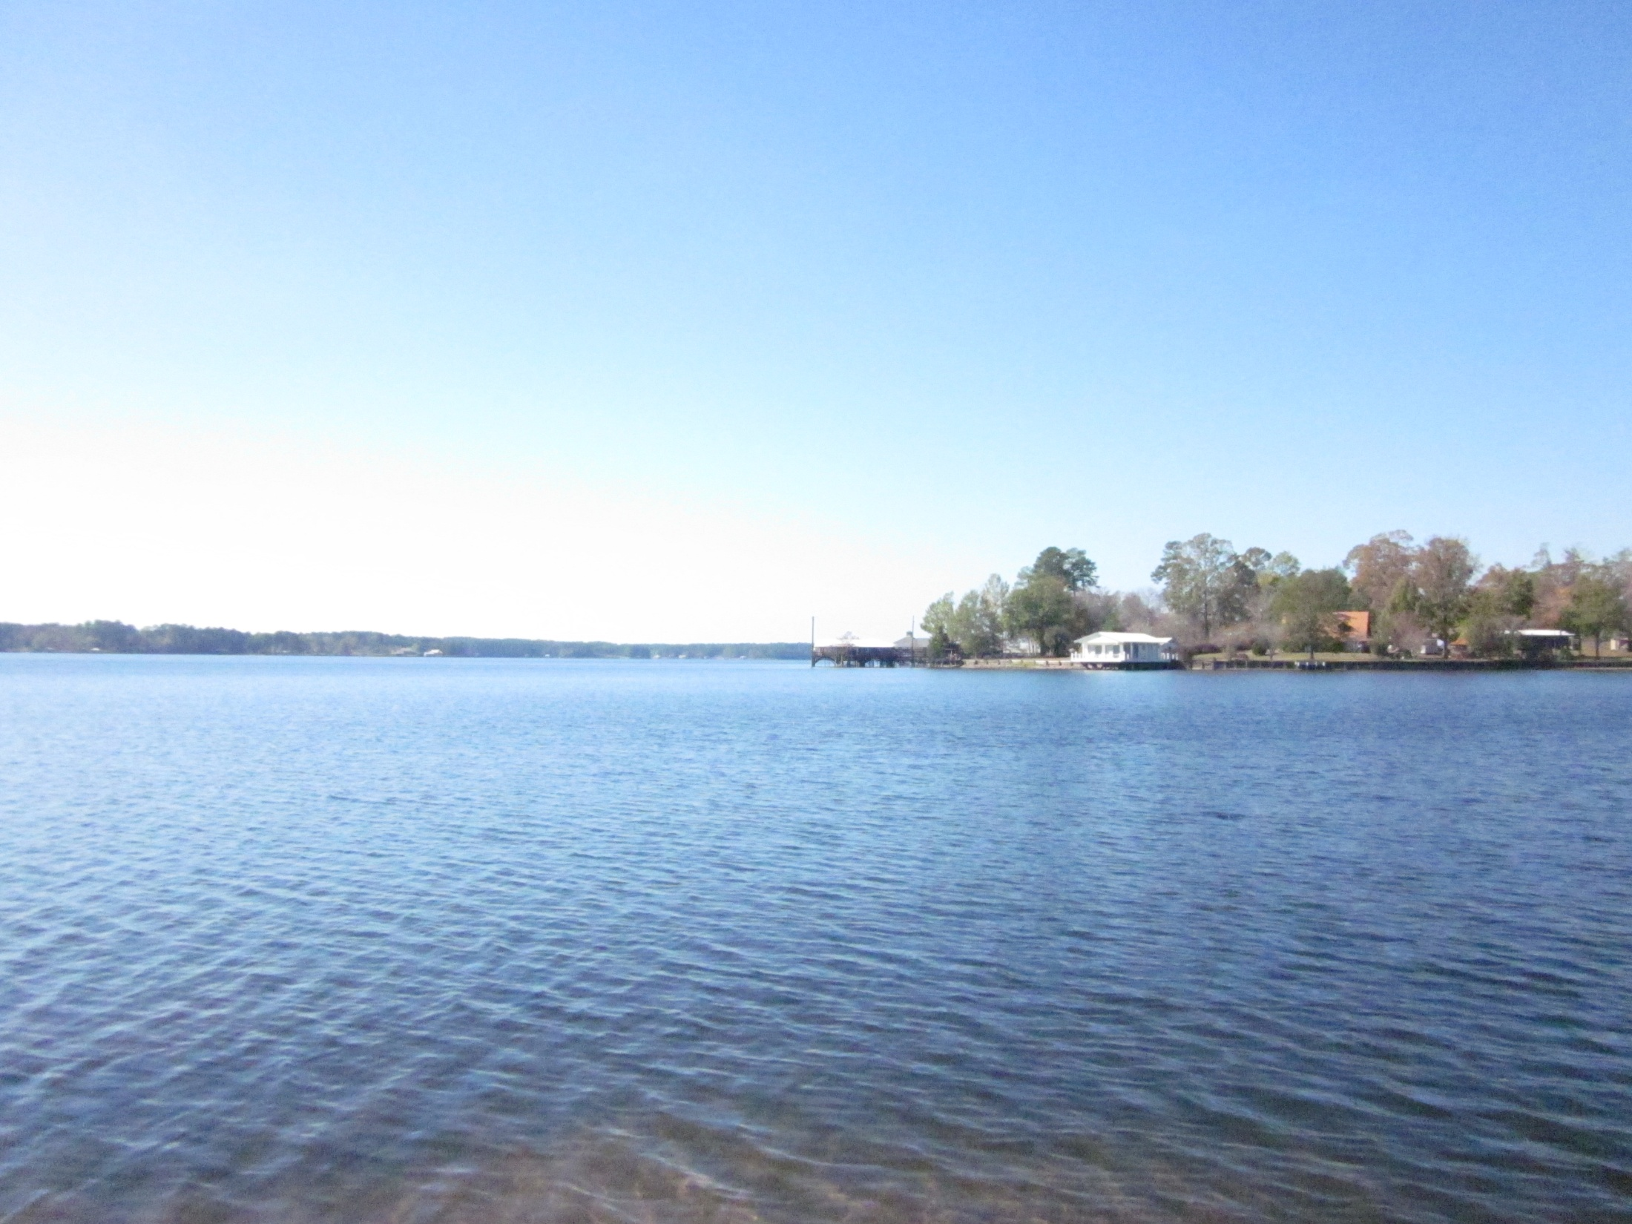
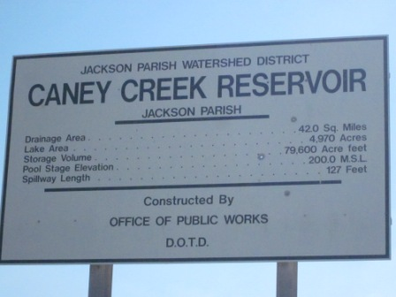
Caney Lake Watershed 081505
Located in Jackson Parish
Louisiana’s 2010 Integrated Report indicated that Caney Lake is fully meeting SCR and FWP uses, but is impaired for PCR because of fecal coliform concentrations.
Very popular recreational and fishing lake; expensive real estate area also.

Slide 3
Activities & Accomplishments
Visual Site Assessments: via satellite imaging & also via watershed drive (11/23, 11/29).
Counted home sites and chicken houses; got a feel for the watershed – areas of denser population & usage; any other notable areas
Stakeholder Involvement
Educational Outreach
PSAs (3/1, 3/15, 3/29, 4/12) > about Caney Lake; Jackson Parish Independent
Watershed Plan: approximately 70% complete; new information to be added

Slide 4
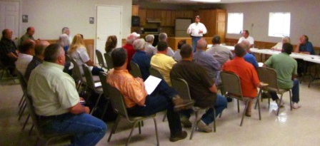
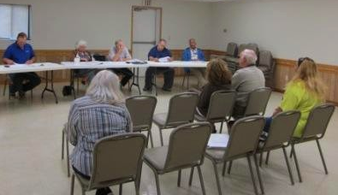
Stakeholder Involvement
Stakeholder Meetings held on March 19th and April 16th
Stakeholders
Dugdemona SWCD
Jackson Parish Police Jury
Jimmie Davis State Park
Caney Lake Watershed Commission > been very helpful, supportive of watershed efforts, and hands-on.
Community/residents/landowners

Slide 5
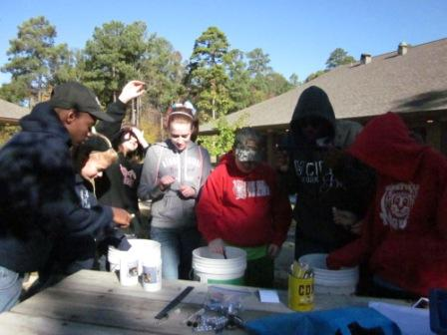
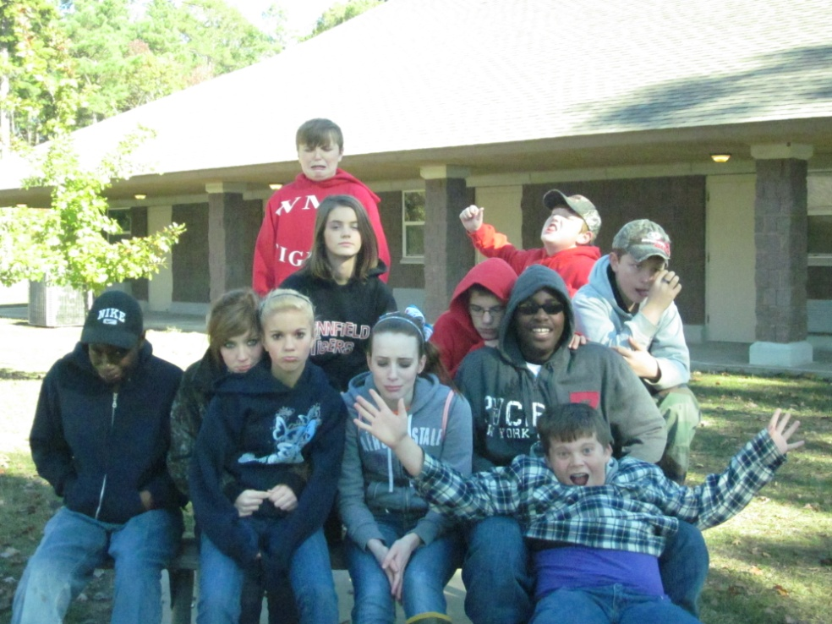
Educational Outreach In Caney Lake Watershed
641 People directly reached Sep 2011-Sep 2012
This was done through presentations at schools, Chamber of Commerce, Police Jury, Library, 4H Survivor Camp, and field trips.

Slide 6
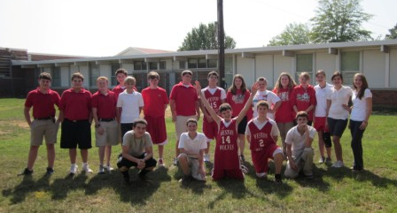
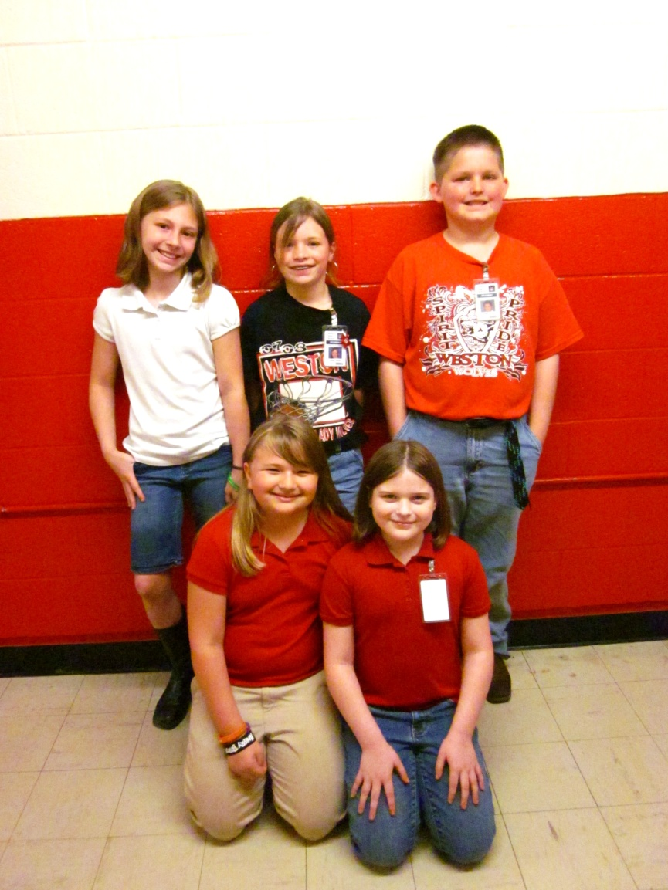
Weston High School
9/26/11
Weston H.S. Essay Contest Winners
3/30/12
Hodge Head Start
11/29/11

Slide 7
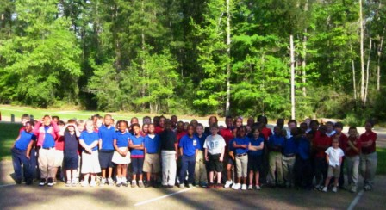
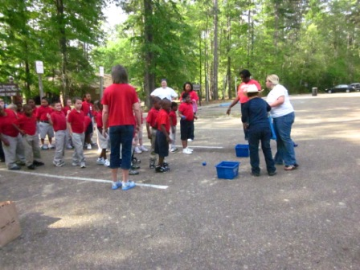
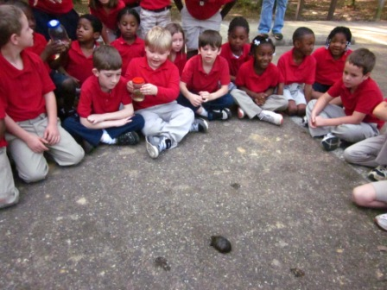
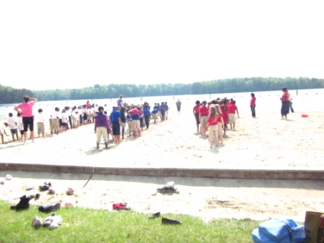
WQ Field Trip at Caney Lake with Southside Elementary 3/27/12

Slide 8
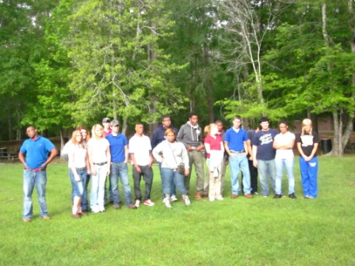
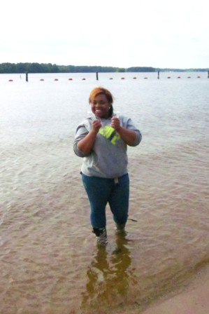
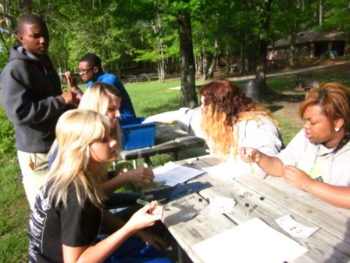
WQ Field Trip at Caney Lake with Jonesboro-Hodge High School 4/3/12

Slide 9
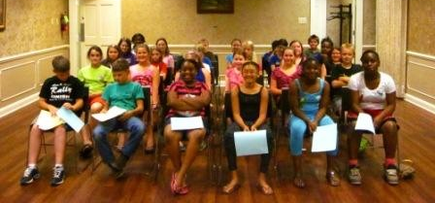
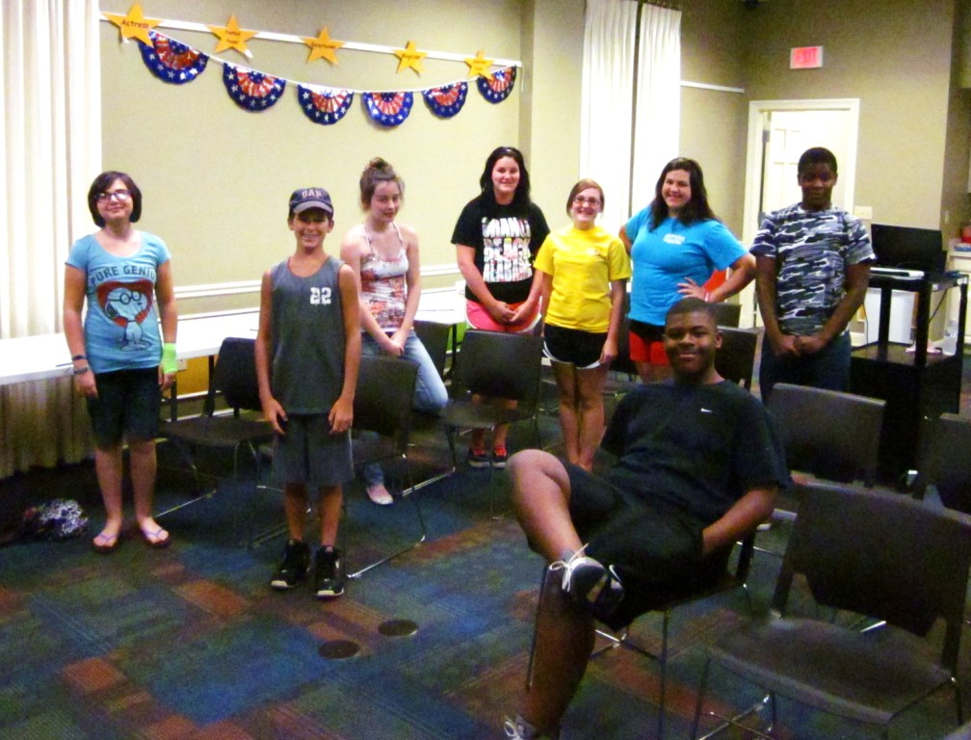
WQ Presentation at Jackson Parish Library 6/13/12
WQ Presentation at Jackson Parish Library 7/9/12

Slide 10
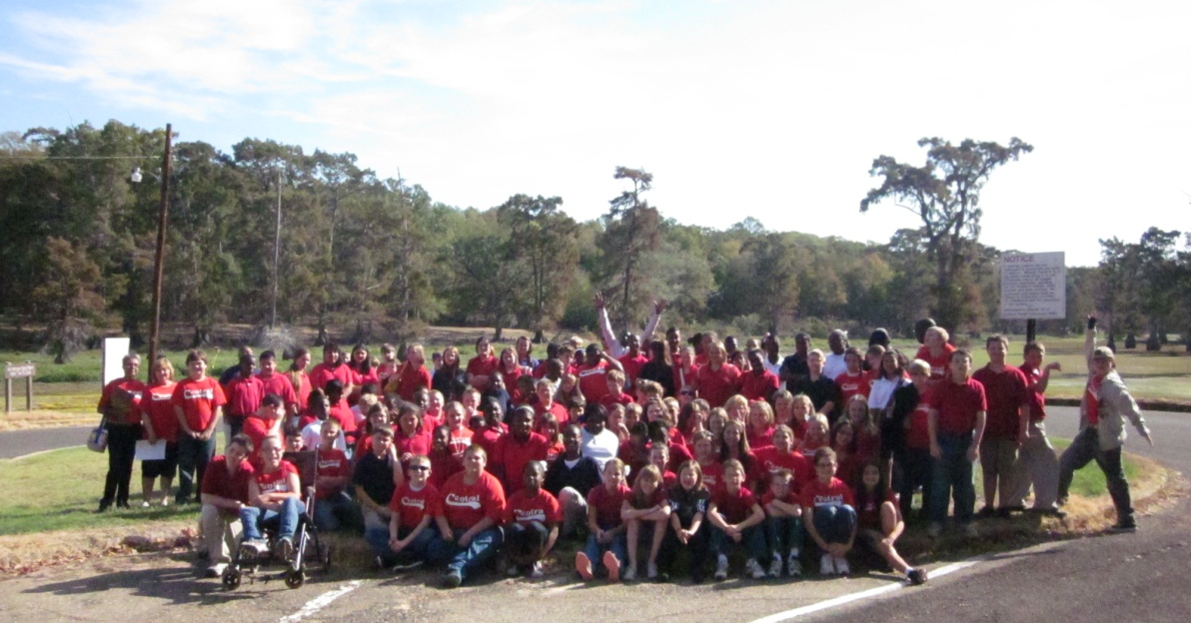
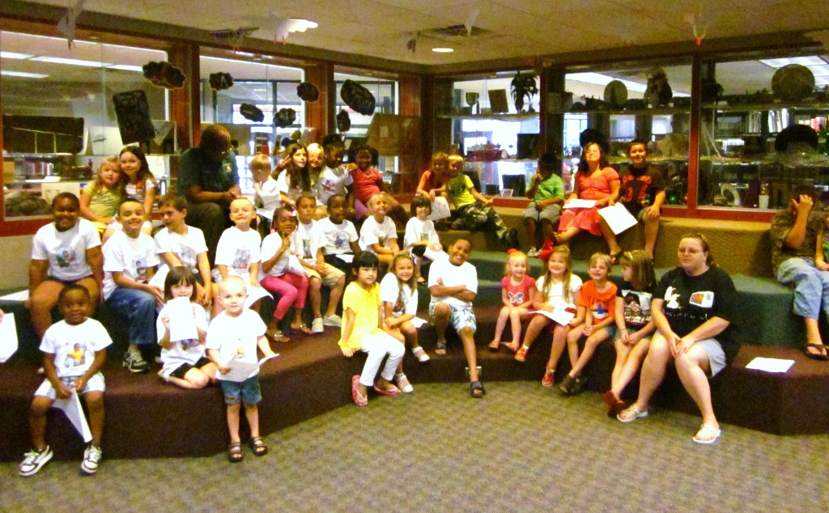
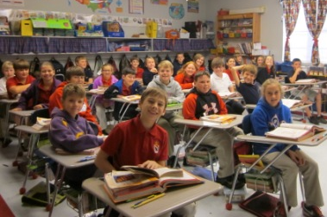
Total WQ Outreach Around TB Parishes for Sep 2011- Sep 2012 = 5,015!
WQ Field Trip to Lake Bistineau State Park with Central Elementary 10/11/11
Springhill Library 7/19/12
Claiborne Academy 11/1/11
Cope Middle School 12/5/11

Slide 11
Other accomplishments & Future Plans
Revisions were made to the previous watershed plan on the Dugdemona River and re-submitted; in addition, a proposal was submitted to have forestry workshops conducted within the Dugdemona watershed.
Continue working on Caney Lake watershed plan; add in new monitoring data. DEQ collected new samples on Caney from March 3, 2012 – July 10, 2012. Finish Plan.
Begin work on new watershed assigned; Cheniere Creek Watershed in Ouachita Parish.

Slide 12
QUESTIONS?
~MERRY CHRISTMAS~

