Slide 1
Underground Storage Tank
Electronic submittal of registration forms and certified worker applications with online fee payment receipts

Slide 2
What’s New
We are pleased to announce that we’ve adopted a new solution that allows you to submit updated UST registration forms, UST registration fees, UST Certified Worker Initial and Renewal Applications with associated fess online, without the hassle of writing a check or mailing a payment and paper forms.

Slide 3
What you will learn
Created and Ebusiness Account
Requesting an Agency Interest Number
Making an online payment of UST Fees
Electronic submittal of UST Registration not requiring a fee
Electronic submittal of UST Registration requiring a fee
Electronic submittal of UST Certified Worker application and fee(s).

Slide 4
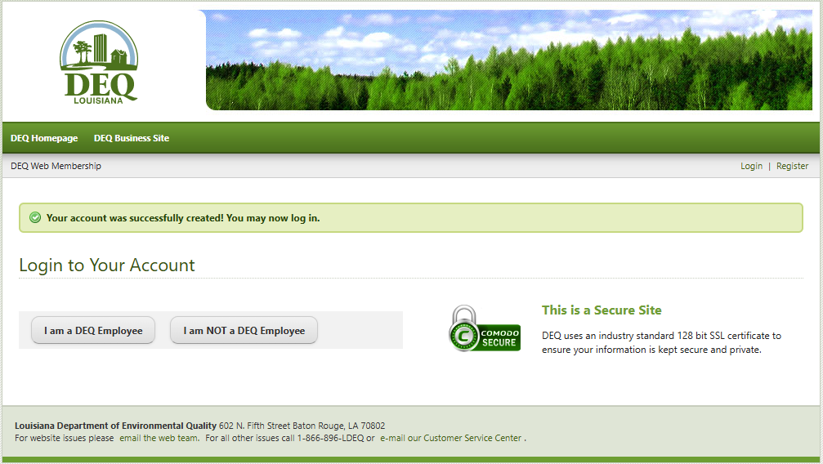
Creating an Ebusiness Account
To Create a EBusiness Account Follow the steps below.
Go to LDEQ’s E-Business web page at: https://business.deq.louisiana.gov/
Click on link Creating a new account
Fill out all fields in the Register for an Account web form and click create account
If your account was created successfully you will have the following message on the screen:

Slide 5
Creating an Ebusiness Account
Video of the Ebusiness Create Account Process

Slide 6
Requesting an Agency Interest Number
All payments made online require an Agency Interest (AI) Number. If you are a new facility or a new Certified Worker you can request an AI electronically following the steps below:
Go to LDEQ’s Agency Interest request web page at: https://internet.deq.louisiana.gov/portal/ONLINESERVICES/AGENCY-INTEREST-EMAIL-CREATION/APPLICATION-FORMS
If you are requesting an AI for new facility for installing new UST tanks select Underground Storage Tank Registration button. If you are requesting and AI for a UST Certified Worker select the Underground Storage Tank Certified Worker button.
Enter data for each field in the form, check the I’m not a robot check box and click save.
An email will be sent to a group of DEQ staff that will generate your AI Number.
Once generated you will receive an email indicating your new AI number assigned.
Use this AI number to pay your fees.

Slide 7
Requesting an Agency Interest Number
Video requesting a new UST Facility AI or Certified Worker AI

Slide 8
Making a UST Online Fee Payment
To make an online fee payment follow the steps below:
Go to LDEQ’s E-Business web page at: https://business.deq.louisiana.gov
Click login now link and click I am not a DEQ Employee button
Enter user name and password then click log in
Click on payments in the top menu
Enter the AI number of the fee you are making payment for and select pay application fee
Click Continue button
In filter list by media select UST. List will filter for available fee payments. Click add to cart the appropriate fee(s) then click on view cart and checkout
If cart looks correct, click continue to payment. (NOTE: New tank fees are for each tank so if you are making payments for multiple tanks adjust the quantity accordingly. The same is true for Certified Worker Certification types. Fee is for each type installation and/or closure you are applying or renewing.)
Enter your email address, select payment method of Bank Account or Card account then enter detail account information , agree to terms and click pay.
And email receipt will be sent to the email you provided in the payment screen.

Slide 9
Making a UST Online Fee Payment
Video of making online fee payment

Slide 10
Electronic Submittal of UST Registration Forms not requiring a fee
The steps to submit are:
Simply update the registration form (a copy can be found at: https://www.deq.louisiana.gov/assets/docs/Forms/UST_REG_FORM.pdf )
Save or scan completed and signed registration form as a pdf file.
Attach it to an email to: USTRegistrations@la.gov . In the subject of the email indicate the Agency Interest (AI) number and name of site.
Finally, send the email.

Slide 11
Electronic Submittal of UST Registration Forms requiring a fee
The steps to submit are:
Simply update the registration form (a copy can be found at: https://www.deq.louisiana.gov/assets/docs/Forms/UST_REG_FORM.pdf )
Save or scan completed and signed registration form as a pdf file.
Create and LDEQ e-business account
Make your online payment
Email your updated registration form and receipt of payment to USTRegistrations@la.gov

Slide 12
Electronic Submittal of UST Certified Worker Application and associated fees
The steps to submit are:
Simply complete and sign application form (a copy can be found at):
Initial – https://www.deq.louisiana.gov/assets/docs/Forms/UST_CC-1.docx
Renewal - https://www.deq.louisiana.gov/assets/docs/Forms/UST_cc_3.docx
Save or scan completed and signed form and associated documents as pdf files.
Make your online payment
Email your application, required documentation, and receipt of payment to USTRegistrations@la.gov

Slide 13
Thank You
Below are contacts if you need help or have questions.
For UST Registrations and Change of Ownership contact:
Amy Smith at: Amy.Smith@la.gov or 225-219-3702
For Certified Work Exams and Renewal contact:
Teri Tharp at: Teri.Tharp2@la.gov or 225-219-3646

