Slide 1
Permits 101:
Understanding the Basics of Air, Water, & Waste Permits
Louisiana Department of Environmental Quality
May 2012

Slide 2
Air Permits
Corey Gautreaux
Air Permits Division
Louisiana Department of Environmental Quality

Slide 3
Office Organizational Chart
ENVIRONMENTAL
SERVICES
ENVIRONMENTAL
COMPLIANCE
ENVIRONMENTAL
ASSESSMENT
SECRETARY
Waste Permits
Air Permits
Permits Support Division
Water Permits
Enforcement
Emergency Response & Radiological Services
Surveillance
Water Quality Assessment
Technology
Remediation
Air Quality Assessment
Laboratory Services
Underground Storage Tank
LEGAL AFFAIRS & REGULATION DEVELOPMENT
COMMUNICATIONS
CRIMINAL INVESTIGATIONS
Business, community outreach & incentives

Slide 4
Organization
Office of Environmental Services
Air Permits Division
Writes and Issues Air permits
Petrochem
Writes air permits for petroleum facilities, chemical manufacturing facilities, and oil and gas production facilities
Manufacturing
Writes air permits for power plants, saw mills, painting and sandblasting, asphalt plants, and miscellaneous facilities
Regulates pollution by issuing multi-media permits consistent with laws and regulations

Slide 5
Louisiana Department of Environmental Quality
Mission Statement
The Department's mission is to provide service to the people of Louisiana through comprehensive environmental protection in order to promote and protect health, safety and welfare while considering sound policies regarding employment and economic development.
Vision To be a respected steward of the State‘s environment.

Slide 6
LDEQ’s Role and EPA
EPA provides oversight of LDEQ’s air quality program.
LDEQ is federally authorized to administer the federal Part 70 (Title V) and New Source Review (NSR) programs.

Slide 7
Air Permits Role
Issue air permits
Shows all applicable operations limits
Basis for Surveillance Division’s inspections
Basis for Enforcement Division’s work
Issue other permitting actions
Variances
Exemptions

Slide 8
Air Permits Role
Provide technical guidance for permit applications
Industry
Community
Work with public and community on permitting activities
Public comments
Public hearings

Slide 9
Basics of Air Permits

Slide 10
The Basics of Air Permits
Clean Air Act (CAA) and
Clean Air Act Amendments (CAAA)
Permitting Authority
Subdivided into “titles”, i.e., Title IV, Title V, etc.
Purpose:
Legally limit the amount of air pollutants released into the air by controlling and limiting releases at the individual source
Required when businesses and industries are capable of reaching or exceeding certain established thresholds of pollutant release

Slide 11
The Basics of Air Permits
The final permit usually contains:
A description of the facility
Specific enforceable standards that apply
Specific limits that apply
Specific monitoring and recordkeeping requirements
Specific reporting requirements

Slide 12
The Basics of Air Permits
The type of permit issued to a facility will depend on three things:
1. The facility’s potential-to-emit (PTE)
2. The type of emissions emitted by the facility
3. The status of the area in which the facility is located

Slide 13
Who needs An air permit?

Slide 14
Who Needs An Air Permit?
Activities that do NOT need an air permit include:
activities conducted on residential property (unless it constitutes a Part 70 source);
distribution or use of pesticides;
mobile sources such as automobiles, trucks and aircraft;

Slide 15
Who Needs An Air Permit?
Activities that do NOT need an air permit include (cont.):
air pollution that does not leave the boundaries of the commercial or industrial plant from which it is emitted;
controlled burning of agricultural by-products in the field or cotton gin agricultural waste; or
controlled burning of timberland, pastureland, or marshlands in connection with timber management or trapping or livestock production;

Slide 16
Who Needs An Air Permit?
Facilities that do NOT need an air permit include those regulated solely because of:
NESHAP for Asbestos Demolition and Renovation (40 CFR 61.145);
Standards of Performance for New Residential Wood Heaters (40 CFR Part 60 AAA); and
Regulations promulgated pursuant to the federal Clean Air Act under 112(r), Prevention of Accidental Releases (e.g., 40 CFR 68)

Slide 17
Who Needs An Air Permit?
Facilities that do NOT need an air permit include those regulated solely because of:
Act 547 of the 2008 Louisiana Legislature
Less than 5 tons per year (TPY) of any criteria pollutant
Less than a total of 15 TPY of all criteria pollutants
Less than Minimum Emission Rate (MER) of any TAP
Not otherwise required to obtain a permit
More information: http://www.deq.louisiana.gov/portal/tabid/2619/Default.aspx

Slide 18
Air Permit Application
Download appropriate application from LDEQ website:
http://www.deq.louisiana.gov/portal/tabid/2619/Default.aspx
Application for Approval of Emissions of Air Pollutants from Part 70 Sources
Application for Approval of Emissions of Air Pollutants from Minor Sources

Slide 19
Permit Types

Slide 20
Permit Types
LDEQ Divides Permits into two basic types:
1) Minor Source Permits
2) Major Source Permits

Slide 21
Permit Types – Minor Source
Minor Source Permits:
How does LDEQ determine if the facility is a minor source?
Type of Emissions
Criteria Pollutants
Hazardous Air Pollutants (HAP) and Toxic Air Pollutants (TAP)
Parish
Attainment Parish
Non-attainment Parish
Potential to Emit (PTE)

Slide 22
Permit Types – Minor Source
What Qualifies for a Minor Source Permit?
Criteria Pollutants (CO, NO_{X}, SO₂, VOC, PM₁₀)
1) Attainment Parish < 100 tpy
2) Non-Attainment Parish
< 50 tpy of NO_{x} or VOC
< 100 tpy CO, SO₂, and PM₁₀
HAP (Federal) and TAP (State)
1) All Parishes < 10 tpy for any single HAP or TAP
2) All Parishes < 25 tpy for aggregated emissions
of HAP or TAP
Federally enforceable Specific condition limiting PTE below one or more of the above listed thresholds.

Slide 23
Permit Types – Minor Source
Types of Minor Source Permits Include:
Portable Source
Small Source
Standard Oil and Gas
Synthetic Minor Source
State Permit
Regulatory Permit

Slide 24
Permit Types – Minor Source
Portable Source
Allow for facility to move locations
Must comply with all other regulations and zoning at new location
Must notify the Department when moving locations
Part 70 Sources are not allowed to have a portable source permit
Permit No. begins with 7777
[LAC 33:III.513.C]

Slide 25
Permit Types – Minor Source
Small Source
Emissions of any pollutant < 25 tpy
Written the same as a Minor Source Permit
Fee is often less
[LAC 33:III.211.B.13.e]

Slide 26
Permit Types – Minor Source
Synthetic Minor Permit
A facility which places an artificial limit on its PTE in order to obtain or maintain minor source status
A federally enforceable condition to limit the PTE is required
Must have a limit, monitoring, recordkeeping, and reporting to be federally enforceable
Public Notice is required

Slide 27
Permit Types – Minor Source
Synthetic Minor Permit – Continued
Example:
Limit:
Crude oil throughput of the truck loading rack, Emission Point 03, shall be limited to no more than 1,134,000 gal/yr.
Recordkeeping/Monitoring:
The total crude oil loaded to the trucks shall be recorded each month, as well as the total crude oil for the last twelve months. These records shall be kept on site and available for inspection by the Office of Environmental Compliance, Surveillance Division.
Reporting:
Throughput above the maximum twelve consecutive month period shall be a violation of this permit and reported to Office of Environmental Compliance, Enforcement Division. A report showing the crude oil throughput to the truck loading rack for the preceding calendar year shall be submitted to the Enforcement Division by March 31st.

Slide 28
Permit Types – Minor Source
State Permit
Most common of the “Permit Types”
Doesn’t fit into one of the other types of Minor Source Permit categories
Regulatory Permit
A permit which is defined in the Regulations
Facility must “fit” the applicable emissions activities
Currently there are five in Louisiana’s regulations (ex. Portable Air Curtain Destructors, Emergency Engines)
Authorized by R.S. 30:2054(B)(9)
LAC 33:III.Chapter 3

Slide 29
What is a Major Source
Major Source as defined per LAC 33:III.502.A
Emits or has PTE ≥ 100 tpy of Criteria Pollutants
PM₁₀, SO₂, CO, NO_{x}, or VOC
Emits or has PTE ≥ 10 tpy of any single HAP, OR 25 tpy of all HAPs
Any major stationary source as defined in Part D (Nonattainment) of Title I of the CAA, including those defined as major under LAC 33:III.504.K
NOTES:
- Contiguous stationary sources must aggregate emissions
- Fugitive emissions are not included unless sources are listed in Table A of Section 509.B or are being regulated under Section 111 (NSPS) or 112 (HAP) of the CAA as of 08/07/1980.

Slide 30
Major Source Programs
Title V (Part 70) Program
Title V of the Clean Air Act (CAA)
40 CFR Part 70 and LAC 33:III.507
New Source Review (NSR) Program
Prevention of Significant Deterioration (PSD) of Air Quality
Title I (Part C) of the CAA
40 CFR Part 52 and LAC 33:III.509
Nonattainment New Source Review (NNSR)
Title I (Part D) of the CAA
LAC 33:III.504

Slide 31
Permit Types - Major Source
Title V (Part 70) Operating Permit
Regular Title V
General Title V

Slide 32
Permit Types - Major Source
Regular Title V Permit
Certified by Responsible Official (RO) & Professional Engineer
Copied to EPA
Federally enforceable permit
Contains emission limitations, testing, monitoring, reporting, and recordkeeping requirements
Public Notice
Initials, Major Modifications, & Renewals
Permit Term = 5 years

Slide 33
Permit Types - Major Source
General Title V Permit
Similar to Regular Title V Permits, except …
Only allowed for certain regulations
Covers numerous similar sources or activities
NOT allowed for New Major Sources or Major Modifications in conjunction with PSD or NNSR
Public Notice
Initials, Major Modifications
Typically used for Oil & Gas Industry
Permit Term = 5 years

Slide 34
Permit Types - Major Source
Regular vs. General Title V – Public Notice Difference
Regular Title V Permit
LDEQ shall publish a notice of the Permit
General Title V Permit
Owner or Operator shall publish a notice of the Application

Slide 35
Major Source Programs
New Source Review (NSR) Program
Prevention of Significant Deterioration (PSD) of Air Quality
Title I (Part C) of the CAA
40 CFR Part 52 and LAC 33:III.509
Nonattainment New Source Review (NNSR)
Title I (Part D) of the CAA
LAC 33:III.504

Slide 36
What is a Major Source
For NSR program, if a stationary source, which is located in:
Attainment parish (PSD source)
Major Source as defined by [LAC 33:III.509.B]
Non-attainment parish (NNSR source)
Major Source as defined by [LAC 33:III.504.K]
Emits or has PTE ≥ 250 tpy of any regulated NSR pollutant
PM₁₀, SO₂, CO, NOx, or VOC
Or if source type is listed in LAC 33:III.509.B.Table A and emits or has PTE ≥ 100 tpy of any regulated NSR pollutant
26 Source types
Most facilities
Emits or has PTE any regulated pollutant at or above threshold values defined in LAC 33:III.504.L.Table 1

Slide 37
Major AIR regulations

Slide 38
Major Regulations That Govern
Louisiana Air Quality Regulations [LAC 33:III]
New Source Performance Standards [40 CFR 60]
National Emissions Standards for Hazardous Air Pollutants [40 CFR 61 and 40 CFR 63]
Acid Rain Regulations [40 CFR 72-78]
National Ambient Air Quality Standards (NAAQS)
Prevention of Significant Deterioration [40 CFR 52]

Slide 39
Louisiana Air Quality Regulations [LAC 33:III]
State administers its own air quality program
Regulates emissions of criteria pollutants and surrogates (PM₁₀, NO_{x}, CO, VOC, SO₂, Lead)
Regulates emissions of Toxic Air Pollutants (LAC 33:III.Chapter 51)

Slide 40
New Source Performance Standards
[40 CFR 60]
Typically applies to
New Sources
Reconstructed Sources
Modified Sources
Technology-based limitations
Other federal regulations are generally more stringent

Slide 41
New Source Performance Standards [40 CFR 60] (cont.)
Examples
40,000 gallon gasoline tank constructed in 1994 must:
Install an internal floating roof;
Install an external floating roof; or
Install a closed vent system that vents to a control device.
Required by 40 CFR 60 Subpart Kb
Lime Kiln at a paper mill combusting natural gas must:
Control PM emissions to 0.15 g/dscm @ 10% oxygen
Required by 40 CFR 60 Subpart BB

Slide 42
National Emissions Standards for Hazardous Air Pollutants [40 CFR 61 and 40 CFR 63]
Applies to sources that emit Hazardous Air Pollutants (HAP)
Incorporates Maximum Achievable Control Technology (MACT)
Typically applies to major sources of HAP
Two varieties:
Pollutant Specific NESHAP (40 CFR 61)
Source Category NESHAP (40 CFR 63)

Slide 43
National Emissions Standards for Hazardous Air Pollutants [40 CFR 61 and 40 CFR 63] (cont.)
Examples:
Shipyard that paints vessels must:
Comply with VOHAP limits (in grams/liter) for each painting application
Required by 40 CFR 63 Subpart II
Incinerator that processes beryllium-containing waste must:
Not emit more than 10 grams/24 hr. period of Beryllium
Required by 40 CFR 61 Subpart C

Slide 44
Acid Rain Regulations [40 CFR 72-78]
Fossil fuel-fired power plants
Affects SO₂ emissions (cap and trade)
Affects NO_{x} emissions (no cap and trade)
LDEQ issues permits, but EPA administers cap and trade program

Slide 45
National Ambient Air Quality Standards (NAAQS)
LDEQ can never permit any activity that violates NAAQS
Primary Standards set to protect public health

Slide 46
National Ambient Air Quality Standards (NAAQS)

Slide 47
Prevention of Significant Deterioration [40 CFR 52]
Prevents deterioration of air quality
More stringent regulatory program
Incorporates Best Available Control Technology (BACT)
Requires sources to control operations at least as well as the best performing similar source, within reason

Slide 48
Prevention of Significant Deterioration [40 CFR 52]
Source is compared to other similar sources using RACT/BACT/LAER Clearinghouse (RBLC): http://cfpub.epa.gov/rblc/cfm/basicsearch.cfm
Source is allowed to take credit for certain decreases in emissions
Source can use economic, technical, or environmental feasibility studies to suggest alternate BACT

Slide 49
internal AIR permit process

Slide 50
Permit Process
Permit Processing
Technical Review & Drafting
Internal Review of
Draft Permit
Public Notice
(minimum 30 days)
Final Decision w/ Basis for Decision and Response to Comments, if applicable
Internal Review of
Revised Draft

Slide 51
Permit Process
Application is received and reviewed for technical deficiencies, enforcement history, and environmental reputation
Permit Writer obtains any necessary additional information from applicant
“Give and take” to draft permit
Applicant is more likely to alter original request than to let LDEQ deny permit

Slide 52
Community involvement

Slide 53
Community Involvement
Submit comments during Public Notice Period
Participate in Public Hearings
Coordinate with environmental advocacy groups
Contact LDEQ staff with questions

Slide 54
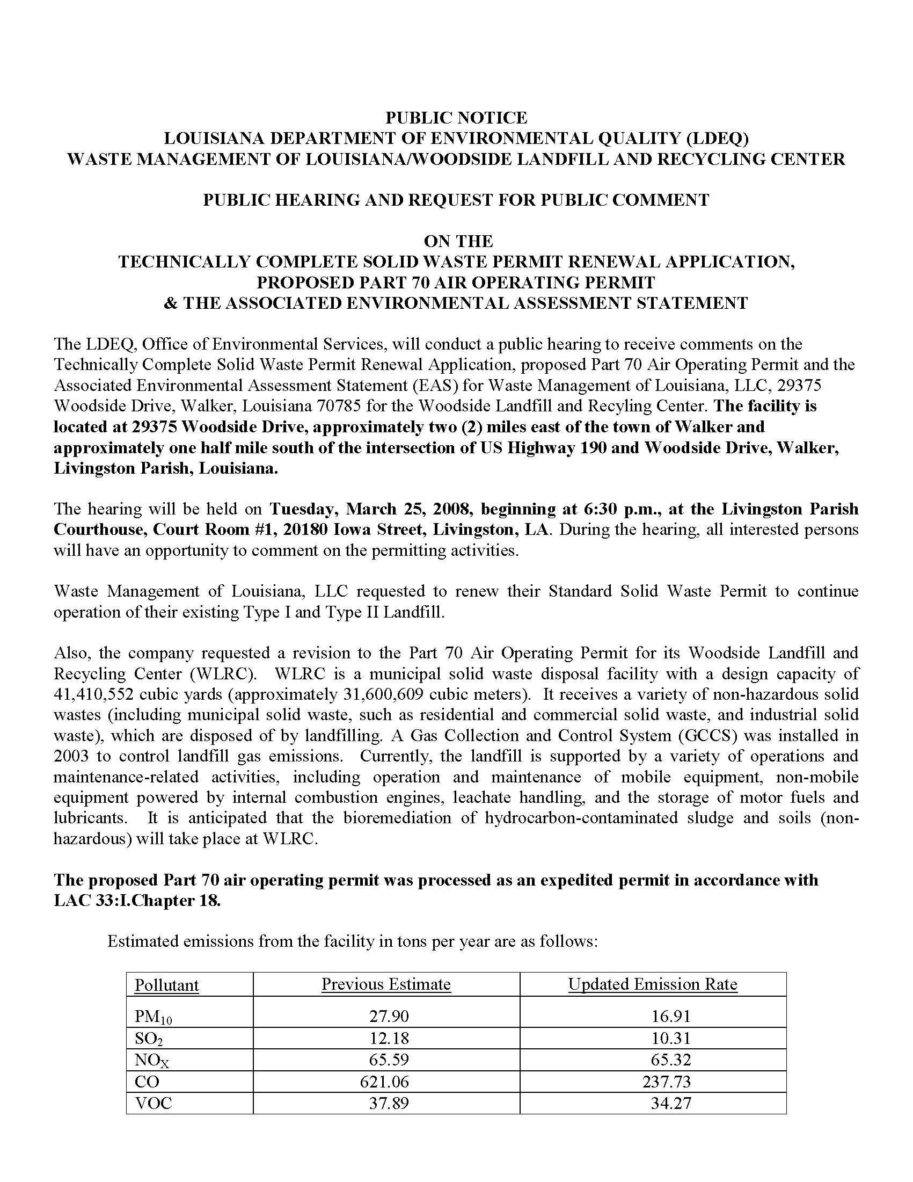
Title

Slide 55
Title

Slide 56
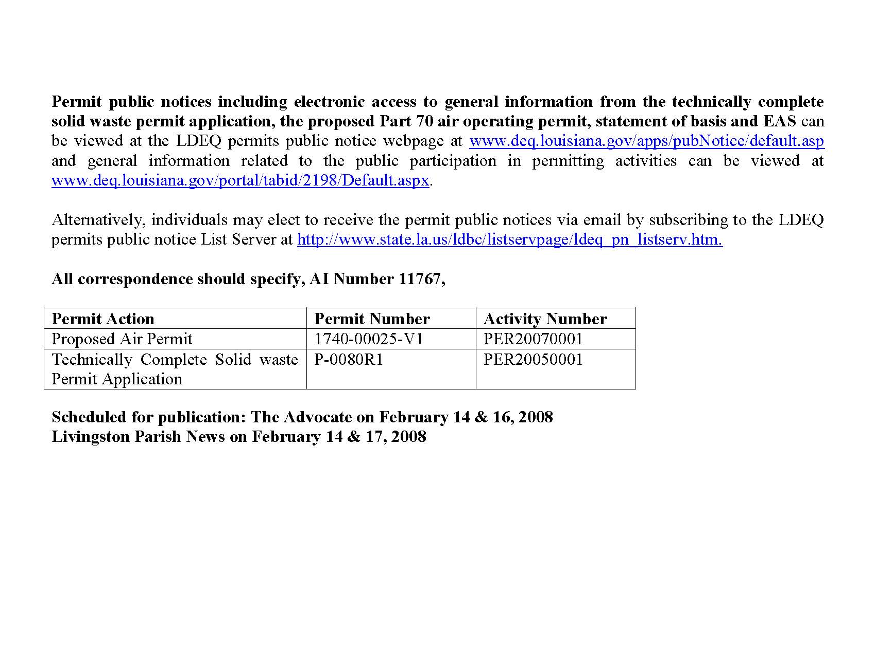
Title

Slide 57
Community Involvement
Materials made available for review during Public Notice period:
Draft permit
Permit application and any additional information submitted
Statement of Basis (if required)
Environmental Assessment Statement (for new facilities and PSD projects)
Materials can be viewed via:
Local Library
Electronic Document Management System (EDMS): http://edms.deq.louisiana.gov

Slide 58
Resources, definitions, and acronyms

Slide 59
Resources
Louisiana Environmental Regulatory Code (LAC)
Title 33 :Part III.Air
Part I. Office of the Secretary
http://www.deq.louisiana.gov/portal/tabid/96/Default.aspx
The Code of Federal Regulation (CFR)
NSPS (40 CFR 60)
NESHAP (40 CFR 61)
http://www.gpoaccess.gov/cfr/retrieve.html
The Clean Air Act (CAA)
The Clean Air Act Amendments (CAAA)
http://www.epa.gov/air/caa/peg/

Slide 60
Resources
DEQ Website
http://www.deq.louisiana.gov/portal/tabid/36/Default.aspx
A weekly list of permit applications received http://www.deq.louisiana.gov/portal/tabid/2824/Default.aspx
A list of permits on public notice http://www.deq.louisiana.gov/apps/pubNotice/default.asp
EDMS – Can be accessed on-line
http://www.deq.louisiana.gov/portal/tabid/2604/Default.aspx
Public Participation Group
http://www.deq.louisiana.gov/portal/tabid/2198/Default.aspx

Slide 61
Definitions and Acronyms
APD Air Permits Division
BACT Best Achievable Control Technology
BART Best Available Retrofit Technology
BMP Best Management Practices (Plan)
CAA Clean Air Act
CAAA Clean Air Act Amendments
CEMS Continuous Emission Monitoring System
CFR Code of Federal Regulations
CMS Continuous Monitoring System
CO Carbon monoxide
Criteria Pollutants These are nitrogen oxide (NOx), sulfur dioxide (SO2), Particulate Matter (PM), Carbon Monoxide (CO), Volatile Organic Compounds (VOC), and Lead (Pb).
DEQ Department of Environmental Quality
EPA Environmental Protection Agency
EDMS Electronic Documents Management System : The repository for all official records created or received by the Department

Slide 62
Definitions and Acronyms
HAP Hazardous Air Pollutant
HON Hazardous Organic NESHAPS
LAC Louisiana Administrative Code
LAER Lowest Achievable Emission Rate
Major Source Facilities with emissions of criteria emissions that equal or exceed 100 tons per year (TPY) or emissions of any one federally-regulated HAP that equals or exceeds 10 TPY or if total HAP emissions for the facility equal or exceed 25 TPY. Lower emission thresholds for a criteria pollutant may apply in nonattainment areas. A facility which has emissions of one or more criteria pollutants above 100 tpy.
MACT Maximum Achievable Control Technology
MER Minimum Emission Rate
Minor Source Facilities with emissions of criteria emissions that are less than 100 tons per year (TPY) or emissions of any one federally-regulated HAP is less than 10 TPY or if total HAP emissions for the facility are less than 25 TPY.
MM Million
MMBTU Millions of British thermal units

Slide 63
Definitions and Acronyms
NAA Nonattainment area
NAAQS National Ambient Air Quality Standards
PM2.5 Particulate Matter of 2.5 microns or less aerodynamic diameter
PM-10 Particulate matter, 10 microns or less in size
NESHAP National Emission Standards for Hazardous Air Pollutants
NSPS New Source Performance Standards
NSR New Source Review
NNSR Non-attainment New Source Review
Pb Lead
PPB Parts per Billion
PPM Parts Per Million
PSD Prevention of Significant Deterioration
PTE Potential To Emit is the emissions from a facility if it is run at maximum all year long.
SCF Standard Cubic Foot
SCFH Standard Cubic Feet per Hour
SCFM Standard Cubic Feet per Minute

Slide 64
Definitions and Acronyms
SCM Standard Cubic Meter
SIC Standard Industrial Classification
SIP State Implementation Plan
SO₂ Sulfur dioxide
SOCMI Synthetic Organic Chemical Manufacturing Industry
SOP Standard Operating Procedures
Synthetic minor source A facility that would be major source except that the emissions are being controlled below the major source emission level. The facility is permitted as a minor source.
Title V Operating Permit Program authorized by Title V of the Clean Air Act
TPY Tons per year
VOC Volatile Organic Compound
TEMPO Tools for Environmental Management and Protection Organizations.: The Department’s official database into which all data for every facility is entered.

Slide 65
Office & Division
Contact Information
Air Permits Division
602 N. Fifth Street
Baton Rouge, LA 70802
225.219.3181
Customer Service Center
225-219-LDEQ (5337)
Toll Free 1-866-896-LDEQ (5337)
Hours 8-4:30 M-F

Slide 66
Speaker Contact Information
Corey Gautreaux
Environmental Scientist III
225.219.3601
Corey.Gautreaux@la.gov
Dustin Duhon
Environmental Scientist Supervisor
225.219.3397
Dustin.Duhon@la.gov

Slide 67
Water Permits
Yvonne Baker, Tom Killeen,
Bruce Fielding, and Kim Corts
Water Permits Division
Louisiana Department of Environmental Quality

Slide 68
Office Organizational Chart
ENVIRONMENTAL
SERVICES
ENVIRONMENTAL
COMPLIANCE
ENVIRONMENTAL
ASSESSMENT
SECRETARY
Waste Permits
Air Permits
Permits Support Division
Water Permits
Enforcement
Emergency Response & Radiological Services
Surveillance
Water Quality Assessment
Technology
Remediation
Air Quality Assessment
Laboratory Services
Underground Storage Tank
LEGAL AFFAIRS & REGULATION DEVELOPMENT
COMMUNICATIONS
CRIMINAL INVESTIGATIONS
Business, community outreach & incentives

Slide 69
LPDES PERMITS PROGRAM
The state water discharge permit program is called the Louisiana Pollutant Discharge Elimination System (LPDES)
LA has authority to implement the Federal (EPA) water permit program called the National Pollutant Discharge Elimination System (NPDES)

Slide 70
National Pollutant Discharge Elimination System (NPDES)
Requirement of the Federal Clean Water Act
Prior to 1996, in Louisiana, NPDES permits were issued by EPA.
In 1996, permitting authority was transferred to LDEQ under the LPDES program.

Slide 71
Louisiana Pollutant Discharge Elimination System (LPDES)
Prior to 1996, water discharge permittees were required to maintain two water discharge permits, from the state and federal government.
With the transfer of permitting authority, permittees now only need one, all encompassing, permit.

Slide 72
WHO NEEDS A WATER DISCHARGE PERMIT?
Any one who discharges pollutants from a point source to waters of the state.
Key definitions:
Pollutants
Point Source
Waters of the State
Must have an effective water discharge permit at the time you start discharging
5 year permits

Slide 73
WHO NEEDS A WATER DISCHARGE PERMIT?
Pollutants – for the purposes of LPDES, as defined in the act, dredged spoil, solid waste, incinerator residue, filter backwash, sewage, garbage, sewage sludge, munitions, chemical wastes, biological materials, radioactive materials, except those regulated under the Atomic Energy Act of 1954, 42 U.S.C. 2011 et seq., as amended, heat, wrecked or discarded equipment, rock, sand, cellar dirt, and industrial, municipal, and agricultural waste discharged into water. LAC 33:IX.2313

Slide 74
WHO NEEDS A WATER DISCHARGE PERMIT?
For the purposes of LPDES, as defined in the act, pollutant does not mean:
water, gas, waste, or other material that is injected into a well for disposal in accordance with a permit approved by the Department of Natural Resources or the Department of Environmental Quality; or
water, gas, or other material which is injected into a well to facilitate production of oil or gas, or water derived in association with oil and gas production and disposed of in a well, if the well used either to facilitate production or for disposal purposes is approved by authority of the state in which the well is located, and if the state determines that the injection or disposal will not result in the degradation of ground or surface water resources. LAC 33:IX.2313

Slide 75
WHO NEEDS A WATER DISCHARGE PERMIT?
Point Source – any discernible, confined, and discrete conveyance, including but not limited to any pipe, ditch, channel, tunnel, conduit, well, discrete fissure, container, rolling stock, concentrated animal feeding operation, landfill leachate collection system, vessel, or other floating craft from which pollutants are or may be discharged. This term does not include return flows from irrigated agriculture or agricultural storm water runoff. LAC 33:IX.2313

Slide 76
WHO NEEDS A WATER DISCHARGE PERMIT?
Waters of the State – for purposes of LPDES, all surface waters within the state of Louisiana and, on the coastline of Louisiana and the Gulf of Mexico, all surface waters extending there from 3 miles into the Gulf of Mexico. For purposes of the Louisiana Pollutant Discharge Elimination System, this includes all surface waters that are subject to the ebb and flow of the tide, lakes, rivers, streams (including intermittent streams), mudflats, sandflats, wetlands, sloughs, prairie potholes, wet meadows, playa lakes, natural ponds, impoundments of waters within the state of Louisiana otherwise defined as Waters of the United States in 40 CFR 122.2, and tributaries of all such waters. Waters of the State does not include waste treatment systems, including treatment ponds or lagoons designed to meet the requirements of the Clean Water Act, 33 U.S.C. 1251 et seq. LAC 33:IX.2313

Slide 77
WHO NEEDS A WATER DISCHARGE PERMIT?
Surface waters – all lakes, bays, rivers, streams, springs, ponds, impounding reservoirs, wetlands, swamps, marshes, water sources, drainage systems, and other surface waters, natural or artificial, public or private, within the state or under its jurisdiction that are not a part of a treatment system allowed by state law, regulation, or permit. LAC 33:IX.1105
Groundwater – water in the saturated zone beneath the land surface. LAC 33:IX. 107
Surface water does not include ground water.

Slide 78
Water Permit Applications
Download appropriate application or notice of intent (NOI) from LDEQ website:
http://www.deq.louisiana.gov/portal/Default.aspx?tabid=1837
General Permits NOIs
Individual Permit Applications

Slide 79
TYPES OF PERMITS
Individual Permits
Majors
Minors
General Permits
Storm water
Non-storm water

Slide 80
INDIVIDUAL PERMITS
Majors - Characteristics
Industrial – determined by point system
Municipal – 1 million gallons/day or greater
Permit Writer (PW) prepares fact sheet
PW sends preliminary draft to permittee for review – 10 days
Preliminary Draft reviewed by EPA – 30 days
Examples: refineries, power plants, chemical plants, sewage treatment plants in large cities
ExxonMobil
Entergy
Dow Chemical
City of Baton Rouge

Slide 81
INDIVIDUAL PERMITS
Minors - Characteristics
Industrial – determined by point system
Municipal < 1 million gallons/day
PW prepares statement of basis
Examples: equipment rental companies, oilfield service facilities, seafood processors, barge cleaning and repair facilities, landfills, sewage treatment plants in smaller cities

Slide 82
ISSUANCE PROCESS for INDIVIDUAL PERMITS
Application – available electronically on LDEQ web page
Note: Application testing requirements are located in LAC 33:IX.2501 and Chapter 71
Application completeness determination
Application assigned to permit writer (PW)
PW may contact applicant to verify information in application
PW may ask for additional information
PW may conduct site visit
PW prepares Statement of Basis or Fact Sheet and Draft Permit
PW sends draft permit to permittee for review – 10 days
Draft Permit public noticed – 30-day public comment period
May have a public hearing – depending on comments
Final Decision issued

Slide 83
GENERAL PERMITS
Storm Water General Permits (4)
Storm Water Associated with Industrial Activity (Multi-Sector General Permit)
Construction 5 acres or greater
Construction < 5 acres
Municipal Separate Storm Sewers Systems (MS4)
Requires Storm Water Pollution Prevention Plan (SWP3) – includes Best Management Practices (BMPs) and Activities

Slide 84
GENERAL PERMITS
Non-Storm Water General Permits
Cement, Concrete & Asphalt Facilities (LAG110000)
Dewatering Petroleum Storage Tanks (LAG300000)
Oil and Gas Exploration, Development and Production facilities in coastal waters (LAG330000)
Potable Water Treatment Plants (LAG380000)
Short-Term and Emergency Discharge (LAG420000)
Auto Dealerships, Paint and Body Shops, Repair Shops (LAG470000)
Light Commercial General Permit (LAG480000)
Sand and Gravel Extraction (LAG 490000)

Slide 85
GENERAL PERMITS
Non-Storm Water General Permits
Sanitary discharges less than 5000 GPD (LAG530000)
Sanitary discharges less than 25,000 GPD (LAG540000)
Sanitary discharges less than 50,000 GPD (LAG560000)
Sanitary discharges less than 100,000 GPD (LAG570000)
Hydrostatic Test Wastewater (LAG670000)
Exterior Vehicle Washwater (LAG750000)
Construction, Demolition Debris Landfills (LAG780000)
Pesticides General Permit (LAG870000)
Cleanup of Petroleum Underground Storage Tanks (LAG830000)
Treated Ground Water Discharges (LAG940000)

Slide 86
AUTHORIZATION PROCESS for COVERAGE UNDER A GENERAL PERMIT
LDEQ public notices and issues ‘Master’ general permit
EPA has 90 days to review/approve ‘master” general permits
Applicant submits Notice of Intent (NOI) – available electronically on LDEQ web page
Authorization may be automatic or require specific authorization by LDEQ
If automatic, authorization is effective within 2 days of submittal of a complete NOI
Specific authorization normally takes 2-4 weeks after submittal of a complete NOI

Slide 87
INFORMATION ABOUT THE PERMIT
Fees
Title page
Effluent Limitations page
Outfall description
Parameters
Discharge limits
Monitoring frequency
Monitoring location

Slide 88
PERMIT INFO (cont.)
Other conditions
Reopener language
Requirements to submit Discharge Monitoring Reports (DMRs)
Storm water pollution prevention requirements
Standard conditions – some basic regulatory requirements
Duty to re-apply – NLT 180 days before expiration date (5 yr permit)
Inspections by LDEQ – right of entry
Enforcement – penalties
Monitoring procedures – must use approved analytical methods

Slide 89
PERMIT INFO (cont.)
Standard conditions (cont.)
Bypass and upset
Record keeping
Proper operation and maintenance
Reporting requirements
Changes
Non-compliance
Emergency situations
Signature requirements

Slide 90
What are Effluent Limits?
Numerical limits on discharges of pollutants
Limits may be expressed as mass (lbs/day) or concentration (mg/L).
Can limit specific pollutant (e.g. cyanide) or an indicator pollutant (e.g. Chemical Oxygen Demand)
Also includes BMPs and SWP3

Slide 91
Types of Effluent Limitations
Two Types of Effluent Limitations
Technology-Based Effluent Limitations (TBELs)
Water Quality-Based Effluent Limitations (WQBELs)
Both TBELs and WQBELs are calculated and the more stringent limit is placed in the permit

Slide 92
Regulatory Basis for TBELs
LAC 33:IX.2707 requires that LPDES permits include effluent limits and standards promulgated under CWA Sections 301(effluent limitations and standards) or 306 (new source performance standards, and 402(a)(1) (case-by-case basis) or a combination

Slide 93
Municipal TBELs– Secondary Treatment Standards
TBELs (mass limits) for POTWs are based on secondary treatment standards and design flow per LAC 33:IX.2709.B.1
85% removal efficiency for BOD₅ and TSS
Pollutant | 30-Day Avg mg/L | 7-Day Avg mg/L
BOD₅ | 30 | 45
TSS | 30 | 45

Slide 94
Industrial TBELs -Effluent Guidelines
Technology-based standards for specified industry categories
Most are production based
mass/unit of product produced
For example: lbs/1000 lbs of product
Some are flow-based
mass/unit volume
For example: mg/L

Slide 95
Regulatory Basis for WQBELs
CWA Section 303(b)(1)(c) and LPDES regulations at LAC 33:IX.2707.D require limits more stringent than TBEL when necessary to attain state water quality standards
Designed to ensure that water quality standards are attained

Slide 96
When is a WQBEL needed in the Permit ?
To determine if a proposed discharge might cause or contribute to violation of water quality standards, the permit writer conducts an evaluation of the “reasonable potential” of the discharge to exceed standards.
If reasonable potential exists, a WQBEL is required in the permit.

Slide 97
Water Quality-based Effluent Limits (WQBELs)
Calculation procedure considers the potential impact of discharges on the receiving water quality
If WQBEL is < TBEL, then WQBEL is used in the permit
Even in absence of TBELS, WQBELs are imposed if there is “reasonable potential” to exceed water quality standards

Slide 98
Calculation of WQBELs
The effluent flow; effluent pollutant concentration; receiving stream flow, TSS, and hardness; and numerical criteria of the receiving stream are utilized to calculate WQBELs
May be calculated using simple, single discharge models (mass balance) or more complex water quality models that consider cumulative impacts of other discharges in the watershed (i.e. TMDL)
WQBELs are fundamentally a mass balance solved for the end-of pipe concentration that will not cause an in-stream exceedance of water quality standards

Slide 99
Louisiana Implementation Policy
Permitting Guidance Document for Implementing Louisiana Surface Water Quality Standards – October 26, 2010, Version 8
Available on LDEQ website
http://www.deq.louisiana.gov/portal/DIVISIONS/WaterPermits/LPDESPermits.aspx

Slide 100
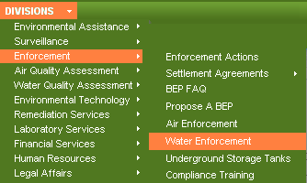
Discharge Monitoring Reports
Blank DMR’s and Sample DMR’s for general LPDES permits can be found on our public web site at: http://www.deq.louisiana.gov:
Minor dischargers are required to submit DMR’s quarterly.
Major dischargers are required to submit DMR’s monthly.

Slide 101
FEES LAC 33:IX.1309
Do not submit fee with application (for water but not all media)
Annual Fee
Individual Permit - determined by rating system
Minimum ($345)
Maximum ($143,451)
Permit issuance fee – 20% of annual fee
General Permit – determined by type of general permit
Lowest ($99)
Highest ($2,640)

Slide 102
WETLANDS ASSIMILATION
LDEQ encouraging new projects
Discharge of secondarily treated sanitary wastewater into a wetland for enhancement
New definitions or wetlands in Water Quality Standards
A feasibility study must be performed prior to LDEQ approval of the wetland assimilation project
Contact Todd Franklin (225) 219-3209; jeremy.franklin@la.gov
Wetlands Website - http://www.deq.louisiana.gov/portal/DIVISIONS/WaterPermits/WetlandAssimilationProjects.aspx

Slide 103
REQUEST FOR PRELIMINARY DETERMINATION
LDEQ developed a Request for Preliminary Determination (RPD)
Problem
Developer obtains a construction general permit to develop the site
Later, application for the discharge from the facility being constructed is submitted
More stringent limitations may be required for the discharge
LDEQ is coordinating with LDHH and local governments on the RPDs
LPDES permits are required prior to discharge – not prior to construction

Slide 104
SEWAGE SLUDGE TRANSPORTORS REGISTRATION
Registration – Registration Form (Form 7159) obtained from the Office of Environmental Services or through the department’s website.
ALL the information required by the form shall be provided.
The registration period - July 1st to June 30th.
All registrations shall expire on June 30th of each year.
To continue the operation of transporting sewage sludge - Apply for re-registration to the Office of Environmental Services by May 1st of each year.
The fee for registration shall be an annual fee of $100.
Contact Eura DeHart (225) 219-3213; eura.dehart@la.gov

Slide 105
BIOSOLIDS/SEWAGE SLUDGE
Regulations apply to:
Sewage sludge generated in the treatment of domestic sewage – does not include non-domestic sludge
Generators, treaters, land application, and disposal of sewage sludge
Includes sewage sludge pumped from residential treatment systems and waste pumped from portable toilets
A permit is required
The date for all facilities to apply for a sewage sludge/biosolids permit has been extended to January 1, 2013
Contact Eura DeHart (225) 219-3213; eura.dehart@la.gov

Slide 106
CONTACT INFORMATION
LDEQ web page - http://www.deq.louisiana.gov/portal/
Most general permits, pretreatment, and biomonitoring:
Kim Corts (225) 219-3208; kim.corts@la.gov
Sanitary permits, landfills, and centralized waste treaters:
Todd Franklin (225) 219-3209; jeremy.franklin@la.gov
Power plants and most minor industrial individual permits:
Angela Marse (225) 219-4054; angela.marse@la.gov
Most major industrial and oil & gas permits:
Jenniffer Sheppard (225) 219-3499; jenniffer.sheppard@la.gov

Slide 107
Water Permits Division Other Activities
Water Quality Certifications (Section 401) for Corps 404 permits
Total Maximum Daily Loads (TMDLs) Studies
Water Quality Standards
Water Quality Assessments
Water Quality Data Review and Approval

Slide 108
Speaker Contact Information
Bruce Fielding
Environmental Scientist Manager
Office of Environmental Services
Water Permits Division
(225)219-3231
Bruce.fielding@la.gov
Kim Corts
Environmental Scientist Supervisor
Office of Environmental Services
Water Permits Division
(225)219-3208
Kimberley.corts@la.gov
Yvonne Baker
Environmental Scientist Senior
Office of Environmental Services
Water Permits Division
(225)219-3193
Yvonne.baker@la.gov
Tom Killeen
Environmental Scientist Manager
Office of Environmental Services
Water Permits Division
(225)219-3207
Tom.killeen@la.gov

Slide 109
Waste Permits
Jason Meyers, P.E.
Engineer Manager
Evita Lagard
Environmental Scientist Senior
Waste Permits Division Louisiana Department of Environmental Quality

Slide 110
Office Organizational Chart
ENVIRONMENTAL
SERVICES
ENVIRONMENTAL
COMPLIANCE
ENVIRONMENTAL
ASSESSMENT
SECRETARY
Waste Permits
Air Permits
Permits Support Division
Water Permits
Enforcement
Emergency Response & Radiological Services
Surveillance
Water Quality Assessment
Technology
Remediation
Air Quality Assessment
Laboratory Services
Underground Storage Tank
LEGAL AFFAIRS & REGULATION DEVELOPMENT
COMMUNICATIONS
CRIMINAL INVESTIGATIONS
Business, community outreach & incentives

Slide 111
Waste Permits Overview

Slide 112
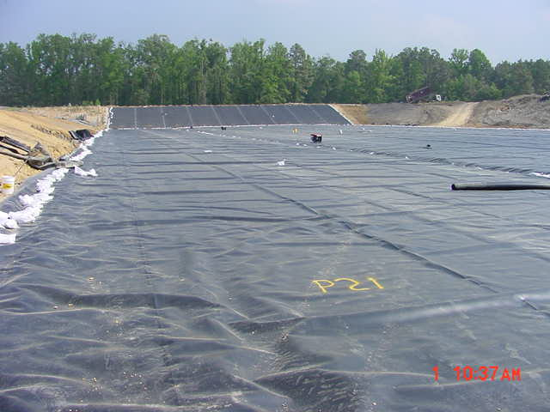
Waste Permits Division
The Waste Permits Division authorizes permits administered under the Solid Waste and Hazardous Waste Regulations
Is responsible for all activities pertaining to the permitting of existing and proposed solid waste processing and disposal facilities.
Facilities include, but are not limited to:
sanitary landfills
industrial landfills
hazardous waste landfills
surface impoundments
landfarms
Incinerators
transfer stations
resource recovery facilities
refuse-derived fuel facilities

Slide 113
Waste Permits Division
Administrator
Solid and Hazardous Waste Permits
Hazardous Waste Engineers
Geology Support
Solid Waste Engineers

Slide 114
Waste Permits Division
Solid and Hazardous Waste Permits Section
Perform technical review of applications
Route documents for review
Solid Waste Engineers
Perform engineering and geotechnical review of solid and hazardous waste applications
Hazardous Waste Engineers
Review tank design, BIF design, trial burn data
Geology support
Review monitoring well design and boring data

Slide 115
Facilities Needing a Solid Waste Permit
LAC 33:VII.509.A.1—Any person who processes and/or disposes solid waste, with the exception of those listed in the regulations.
Generators and transporters that are not processors or disposers of solid waste are not required to secure a permit.
Collection facilities and non-processing transfer stations at which no solid waste is processed or disposed of are not required to secure a permit.

Slide 116
Types of Solid Waste Permits
Temporary Permits
Allows continued operation of an existing facility but does not allow the expansion or modification of the facility without prior approval
Duration: Not to exceed three years
Standard Permits
Issued for solid waste processing and/or disposal facilities that have successfully completed the standard permit application process.
Types: Type I, Type I-A, Type II, Type II-A, and Type III
Duration: not to exceed ten years
Exception: Landfills may be permitted up to 20 years.

Slide 117
Types of Solid Waste Permits
General Permit. General permits may be issued to facilities with operations that are similar in nature and shall provide conditions that each facility that is authorized to operate under the general permit shall follow. Issuance of a general permit shall follow the procedures of a standard permit regarding draft decisions, public notice, and final decisions.
Regulatory Permit. Regulatory permits may be issued by the administrative authority when it is determined to be appropriate considering the type of operations or facilities that would be covered. Regulatory permits shall be promulgated in accordance with the procedures provided in R.S. 30:2019.

Slide 118
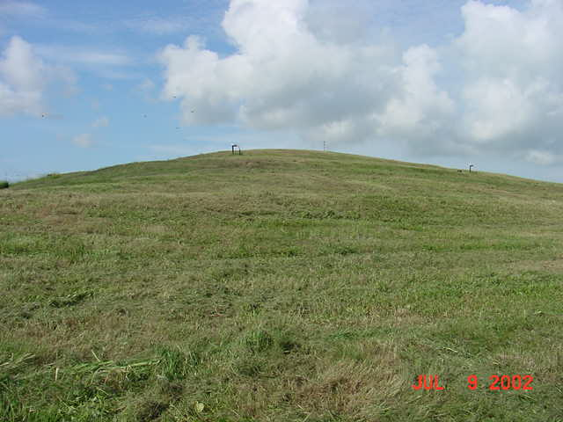
Types of Solid Waste Permits
Closure Permit. Closure permits may be issued to allow closure activities to occur in accordance with an approved closure plan.

Slide 119
Types of Solid Waste Facilities
Type I
Industrial disposal facilities (e.g., landfills, surface impoundments, or landfarms);
Type I-A
Industrial processing facilities (e.g., balers, shredders, transfer stations (processing), etc.);
Type II
Non-industrial disposal facilities (e.g., landfills, surface impoundments, landfarms);
Type II-A
Non-industrial processing facilities (e.g., composting municipal solid waste facilities, balers, shredders, transfer stations (processing), refuse-derived fuel facilities, autoclaves, etc.); or
Type III
Construction/demolition-debris and woodwaste landfills, separation facilities, composting facilities, or other.

Slide 120
§513. Permit Process for Existing Facilities and for Proposed Facilities
513.B. Pre-Application Requirements. All prospective applicants for solid waste permits, except for those applicants exempted under Paragraphs 9-12 of this Subsection, shall comply with the following requirements prior to submitting an application for a solid waste permit:
513.B.1The prospective applicant shall conduct a capacity evaluation regarding the need for the type of facility to be requested in the location proposed and forward the results to the department.
513.B.2The prospective applicant shall obtain written confirmation from the appropriate municipal or parish governing authority where the facility is proposed to be located indicating that the facility is or will be in compliance with all existing local zoning and land use restrictions.

Slide 121
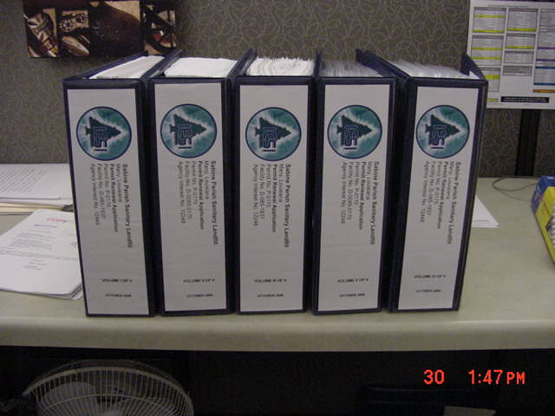
§513. Permit Process for Existing Facilities and for Proposed Facilities
Public notice of intent to submit an application
(No sooner than 45 days prior to submittal)
State journal (The Advocate)
Parish journal

Slide 122
Permitting Process
Administrative completeness review
Application Verification Group
Verifies all parts of the application are included.
Verifies fee has been included

Slide 123
Permitting Process
Submittal of fees
Type I, I-A, II, II-A--$3,300
Type III--$660

Slide 124
New Permit Applications
An application is required for ALL submittals after 11/20/11.
Applications are currently available for:
Type I/II Landfills
Type III C/D and/or Woodwaste Landfills
Type I/II Surface Impoundments
Type IA/IIA Processing Facilities
Type III Woodwaste Processing and/or Separation
Waste Tire Processing Facilities
Composting Facilities
Beneficial Use

Slide 126
Permitting Process
Technical completeness review
Copies of the application are routed for review to:
Environmental Scientist
Engineer
Geologist

Slide 127
Permitting Process
Deficiencies
Notice of Deficiencies
Items which require clarification or more information.
Response to Notice of Deficiencies

Slide 128
Permitting Process
Technical completeness determination
All deficiencies have been addressed
Draft Permit decision
Once an application is deemed technically complete, the administrative authority shall prepare a draft permit decision to issue or deny the requested permit. If a draft permit is prepared, the draft permit shall contain the following information:
a. all conditions proposed for a final permit under LAC 33:VII.Subpart 1; and
b. any compliance schedules proposed for the facility.

Slide 129
Draft Permit Decision
Fact Sheet.
For all draft permit decisions, the department will prepare a fact sheet describing the department’s reasoning for the issuance of the draft permit decision. This fact sheet shall contain:
a brief description of the facility and the activity;
the type and quantity of wastes which are proposed to be or are being processed or disposed;
a brief summary of the justification for the draft permit conditions
a description of the procedures for reaching a final decision;
the name and telephone number of a person to contact for additional information; and,
any additional information, as necessary.

Slide 130
Permitting Process
30-day public comment/review period
Copies of the technically complete application are sent to and available for review at the following locations:
DEQ Headquarters in Baton Rouge
DEQ Regional Office
Local Library
Local Government Office

Slide 131
Permitting Process (cont.)
30-day public comment/review period
Public is allowed to submit written comments in favor or in opposition of granting the standard permit (all reasonable comments will be addressed)
Public is allowed to request a public hearing
A summary and/or Basis for Decision is drafted and routed to the Assistant Secretary, and a permitting decision will be made

Slide 132
Hazardous Waste Permitting
Same basic permitting process:
Public notice is placed prior to submittal
Administrative completeness review

Slide 133
Hazardous Waste Permitting (cont)
General requirements for Hazardous Waste submittals:
Everyone addresses Chapter 5
Includes:
Chapter 515 (Part I)
(checklist)
Chapter 517 (Part II)
Site specific information

Slide 134
Hazardous Waste Permitting (cont)
General requirements for Hazardous Waste submittals:
Everyone also addresses Chapters 15, 17, 33, 35, and 37.
Chapter 15- Treatment, Storage, Disposal facilities
Chapter 17- Air Emission Standards
Chapter 33- Groundwater Protection
Chapter 35- Closure and Post-closure
Chapter 37- Financial Assurance

Slide 135
Hazardous Waste Permitting (cont)
Depending on type of facility may also need to address the facility specific standards in Chapters 18-32.

Slide 136
Hazardous Waste Permitting (cont)
Deficiencies
Notice of Deficiencies
Response to Notice of Deficiencies
Prepare draft permit
Public notice
45 day public notice for Hazardous Waste

Slide 137
Hazardous Waste Permitting (cont)
A responsiveness summary is drafted and routed to the Assistant Secretary, and a permitting decision will be made

Slide 138
Waste Terms & Definitions
Solid Waste
Any garbage, refuse, or sludge from a waste treatment plant, water-supply treatment plant, or air pollution-control facility, and other discarded material including solid, liquid, semi-solid, or contained gaseous material resulting from industrial, commercial, mining, and agricultural operations, and from community activities.
Hazardous Waste
Waste identified as hazardous in the current Louisiana hazardous waste regulations (LAC 33:V.Subpart 1) and/or by the federal government under the Resource Conservation & Recovery Act and subsequent amendments.

Slide 139
Waste Terms & Definitions
Generator: Any person whose act or process produces solid waste as defined in the regulations.
Transporter: Any person who moves industrial solid waste off-site and/or who moves solid waste of a commercial establishment or more than one household to a storage, processing, or disposal facility.
Type I Facility: A facility used for disposing of industrial solid waste. (If the facility is also used for disposing of residential or commercial solid waste, it is also a Type II facility).
Type I-A Facility: A facility used for processing industrial solid waste (e.g. transfer station, incinerator waste-handling facility, shredder, baler, or compactor). (If the facility is also used for processing residential or commercial solid waste, it is also a Type II-A facility).

Slide 140
Waste Terms & Definitions
Type II Facility: A facility used for processing residential or commercial solid waste (e.g. transfer station, incinerator waste-handling facility, refuse-derived fuel facility, shredder, baler, or compactor). (If the facility is also used for processing industrial solid waste , it is also a Type I-A facility).
Type II-A Facility: A facility used for processing residential or commercial solid waste (e.g. transfer station, incinerator waste-handling facility, refuse-derived fuel facility, shredder. baler. or compactor). (If the facility is also used for processing industrial solid waste, it is also a Type I-A facility).
Type III Facility: A facility used for: disposing of construction/demolition debris or woodwaste, composting organic waste to produce a usable material, or separating recyclable wastes (a separation facility). Residential, commercial, or industrial solid waste must not be disposed of in a type III facility.

Slide 141
Resources
LAC 33:VII (Solid Waste Regulations) or LAC 33:V (Hazardous Waste Regulations)
http://www.deq.louisiana.gov/portal/tabid/1674/Default.aspx#Title33
Solid Waste Information and Guidance Document
http://www.deq.louisiana.gov/portal/tabid/259/Default.aspx
http://www.deq.louisiana.gov/portal/Default.aspx?tabid=247
Hazardous Waste Information and Guidance Document
http://www.deq.louisiana.gov/portal/tabid/2267/Default.aspx
http://www.deq.louisiana.gov/portal/Portals/0/permits/haz/General%20Guidelines%20H W%20App.pdf
http://www.deq.louisiana.gov/portal/Portals/0/permits/haz/Statement%20of%20Acknowledgment%20and%20Non-ApplicabilityADD6.30.pdf

Slide 142
Division Contact Information
Office of Environmental Services
Waste Permits Division
PO Box 4313
Baton Rouge, LA 70821-4313
Phone: (225) 219-3462
Fax: (225) 219-3474

Slide 143
Speaker Contact Information
Questions:
Jason Meyers, P.E.
(225) 219-0791
jason.meyers@la.gov
Evita Lagard
(225) 219-3388
Evita.lagard@la.gov

