Slide 1
Noranda Alumina LLC Agency Interest No. 1388
Photo credit: Advocate staff photo by Hilary Scheinuk

Slide 2
Noranda Alumina LLC

Slide 3
Facility Background
Noranda is located at 1111 East Airline Highway in Gramercy, St. James Parish, Louisiana
Facility construction began in 1957 and operations commenced in 1959
The facility is an alumina refinery
Ownership and/or operator change effective September 30, 2004
Old owner-Kaiser Aluminum & Chemical Corporation
New owner-Gramercy Alumina LLC
Company name change effective September 14, 2009
Old company name: Gramercy Alumina LLC
New company name: Noranda Alumina LLC

Slide 4
Facility Description
The alumina refinery produces roughly 1.2 million tons of alumina/year
Alumina is extracted from Jamaican bauxite via the Bayer Process (involves chemical and physical processes)
The Jamaican bauxite is obtained from Noranda Jamaica Bauxite Partners in Jamaica and is received at the facility’s dock on the Mississippi River
Mercury is a naturally occurring metal found in Jamaican Bauxite

Slide 5
Permitting
Air Permits
Raw material receiving and process area
Red mud processing area (processes raw material for use in various processes via drying, amending, transfer, and storage equipment)
Area that receives and impounds the washed mud in the mud lakes
The facility is not currently permitted for mercury emissions
Water Permits
Currently operating under an administratively continued LPDES permit
A draft renewal is under review for public notice. EPA has reviewed the draft permit
Noranda’s draft LPDES renewal contains 3 final outfalls which discharge to the Mississippi River and 4 which discharge to Blind River Swamp via local drainage
DEQ will require monitoring for Mercury in permit renewal

Slide 6
Current Groundwater Monitoring
Facility conducts groundwater monitoring around the facility.
47 groundwater monitoring wells are sampled, 24 of which are in what is called “assessment” monitoring
Sampled in 10 foot and 50 foot permeable zones
Concentrations of Mercury are well below groundwater protection standards in 10 foot zone and not detected in the 50 foot zone
The drinking water standard is 0.002 mg/L
The groundwater protection standard for this zone is 0.33 mg/L
The mercury concentration detected is 0.00033 mg/L – one thousand times below the groundwater protection standard for this zone.

Slide 7
Groundwater Monitoring Well Network

Slide 8
Noranda Reports Mercury Release
On April 25, 2014 Noranda submitted a release report for the potential release of small amounts of Mercury.
Subsequent to the report, Noranda contacted Enforcement to schedule a meeting.
A meeting was conducted May 8, 2014

Slide 9
Department Response
May 8, 2014 - In the meeting Noranda informed the Department of the following:
On March 26, 2014: 2- 3 ounces of elemental mercury residue discovered by the facility during re-tubing of the No. 1 West Heater
On April 11, 2014: industrial hygiene survey conducted by the facility
The facility determined the following possible sources of mercury
Bauxite (primary source)
Caustic used in the Bayer Process (possible secondary source)
The facility identified up to 36 potential mercury emission points

Slide 10
Department Response
On June 4, 2014 the Department received an interim limits request for mercury dated May 28, 2014.
Requested interim limits: 250 lbs/year
DEQ requires analysis on mercury emission rates above 25 lbs/ year
On June 13, 2014 DEQ informed the facility that the interim limit request could not be acted upon without modeling to demonstrate compliance with Louisiana’s Toxic Air Pollutant (TAP) ambient air standards.
Prior to conducting modeling facilities must submit a modeling protocol to the Air Permits Division for approval.
Notes:
Minimum Emission Rate for Hg is 25 lbs/year
Modeling protocols are submitted to and approved by the Air Permits Division. Modeling must include sources, relative concentrations, meteorological data, and information regarding specific sources such as emission rates, stack height, exit temperature, etc. depending on the nature of the emission source.
Between June and February 2015 there were discussions between the enforcement group, Air Permits and the facility regarding the submittal of the modeling protocol.
In late July or early August, enf spoke to Tien, but a protocol had not yet been received
By the end of November, no protocol had been received, and enf & permits set up a call with the company in early December.

Slide 11
Department Response
On February 20, 2015, DEQ issued a Consolidated Compliance Order & Notice of Potential Penalty based on unpermitted mercury emissions and ordered the following:
Submit a mercury modeling protocol for approval
Conduct air modeling exercises in accordance with approved protocol. Submit results within 30 days.
Based on the modeling results, submit the appropriate air permit application within 30 days of submitting the modeling results
The Compliance Order’s requirements were based on the Respondent’s interim limits request for 250 lb./yr. for mercury.

Slide 12
Department Response
On March 17, 2015, Noranda provided the Department with additional information indicating mercury emissions are far less than the 250 lbs per year that was initially anticipated.
The revised estimates were based on process knowledge from other similar facilities.
The revised emission estimate was 20 lbs/year.
On March 25, 2015, DEQ amended its order to require the following:
Submit a written protocol for mercury quantification activities
Conduct mercury quantification activities in accordance with a DEQ approved protocol. Submit results within 30 days of completion.
Based on the mercury quantification activities, submit the appropriate air permit application within 30 days of submitting the results.
Notes:
Company indicated modeling not required for a minor source
Company provided information updating the estimated amount of mercury to be 20 lbs/year
TALK ABOUT CONSERVATIVE ESTIMATES FOR INITIAL REPORTING AND FINAL REPORTING LATER.
This information was obtained from a site in Texas that is similar to the Gramercy site.
The Tx site uses the same Jamaican bauxite, the same process and similar production rate. TRI Emissions reported to EPA between 2011-2013 are less than 10 lbs/year.
DEQ reached out to TCEQ and verified that the sites were comparable for the purpose of emissions estimation
The order was subsequently amended

Slide 13
Mercury Quantification Protocol
The Department received the protocol on March 26, 2015
A request for additional information was sent on March 31, 2015
The Department received a revised protocol with the additional information included April 30, 2015
The mercury quantification protocol was approved by the Department and issued on May 1, 2015.
The approval will expire 45 days after the issuance date. (Note: The facility has 45 days to complete the sampling process, not 45 days to complete all activities listed on the previous slide)
Sampling is currently taking place.

Slide 14
DEQ Approved Quantification Protocol
Four consecutive weekly composite sampling events for each element in production process
Sampling locations: bauxite, calciner feed, final product, final mud washer mud
If other process raw materials, additives or condensate are found to contain mercury they will be sampled.
Any elemental mercury found will be appropriately collected
The process feed and discharge rates for all sampling locations will be continuously recorded .
Pace Analytical Services, a state accredited laboratory, will perform the analysis.
Based on results of sampling, DEQ may require stack testing per Department policy.
Notes:
Approved methods for each media (air water soil)
Accredited labs – DEQ accredits laboratories for certain methods. Data sent by labs that are not accredited are not accepted by the dept for purpose of compliance or permitting

Slide 15
Mercury Quantification Protocol Timeline
Mercury Sampling Event | Week 1 | Week 2 | Week 3 | Week 4 | Quantification report submitted | Emission Test Report to LDEQ
1 week after LDEQ approval
30 days after receiving final sampling results
60 days after quantification report
SAMPLING

Slide 16
Department Response - MAML
March 16-17, 2015: Mobile Air Monitoring Lab (MAML) monitored the air mercury emissions near the facility
MAML site #1: the “Moni Carlo” truck stop and casino at 5353 W. Airline Highway, Gramercy, LA 70051, St. John the Baptist Parish
Relative position of center of Noranda Alumina to the MAML from site #1: 2.80 miles
MAML site #2: corner of Marigold St. and River Road in Mt. Airy, St. John the Baptist Parish, Louisiana 70051
Relative position of center of Noranda Alumina to the MAML from site #2: 1.83 miles

Slide 17
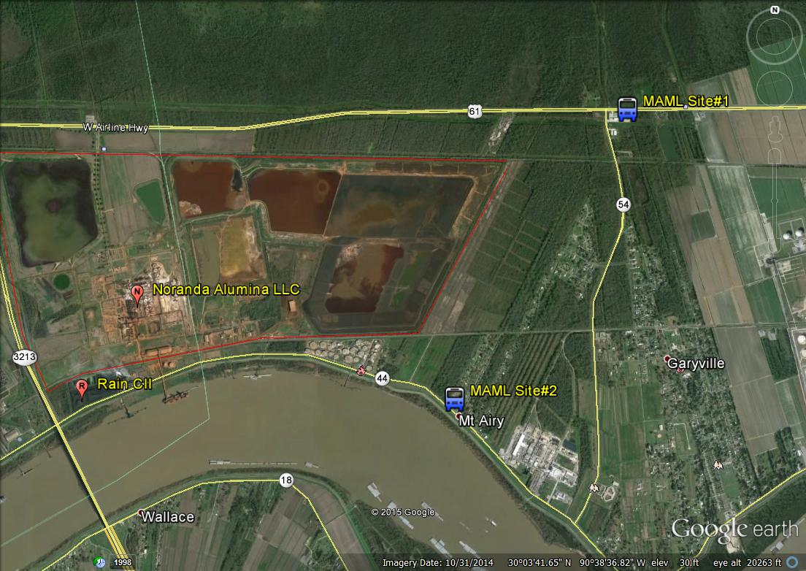
MAML Locations – 1st visit

Slide 18
Department Response - MAML
May 18-22, 2015: MAML again monitored the air mercury emissions near the facility
MAML site #1: near the corner of Hwy 621 and Hwy 3213 in St. James Parish
Relative position of center of Noranda Alumina to the MAML from site #1: 1.2 miles
MAML site #2: the “Moni Carlo” truck stop and casino at 5353 W. Airline Highway, Gramercy, LA 70051, St. John the Baptist Parish
Relative position of center of Noranda Alumina to the MAML from site #2: 2.80 miles
MAML site #3: Wallace, St. John the Baptist Parish, Louisiana 70049
Relative position of center of Noranda Alumina to the MAML from site #3: 1.4 miles

Slide 19
MAML Locations – 2nd visit

Slide 20
MAML Results
ug/m³ | 8-hour average | Hourly average | 5-minute average
Maximum | 0.0051 | 0.013 | 0.07
The Louisiana Ambient Air Quality Standard 8-hr average for mercury is 1.19 µg/m³
Disclaimer: The results are not representative of exclusively Noranda’s emissions. The MAML is going to detect mercury emissions in the area, but does not determine the source of the emissions.

Slide 21
Mercury (Hg)
Mercury is a naturally occurring element that exists in three forms
Metallic mercury Hg (0)
Inorganic mercury Hg(II)
Organic mercury Me-Hg
Concentrations of mercury in the environment have increased over many years due to man-made activities world wide
Primarily due to atmospheric deposition from fossil fuel combustion, mining, smelting, and solid waste incineration

Slide 22
Mercury Biogeochemical Cycle
Source: adapted from slides prepared by USEPA and NOAA

Slide 23
Potential Health Effects of Mercury and Mercury Compounds
Because mercury occurs naturally in the environment, everyone is exposed to very low levels via the air, water, food
Factors affecting the potential for, and type of, adverse health effects associated with mercury exposure include:
Form and concentration of mercury
Frequency, duration, route of exposure
Age and health of the person exposed
Potential health effects of mercury exposure may include:
Nervous system effects (metallic vapor and methyl mercury)
Kidney damage (inorganic mercury)
Gastrointestinal, respiratory, and cardiovascular system effects
Skin effects

Slide 24
Blind River Mercury Fish Consumption Advisory

Slide 25
Blind River Fish Advisory
Fish consumption advisory originally issued 4-23-98; revised 5-29-03
Advisory affects Blind River in Ascension, Livingston, St. James, and St. John the Baptist parishes, from origin to Lake Maurepas
Advisory Recommendations:
Women of childbearing age and children less than seven years of age should consume no more than one meal per month of bowfin from the advisory area
Other adults and children seven years of age and older should consume no more than four meals per month of bowfin from the advisory area
Unless fish species is specifically addressed in the advisory, limit consumption of all species in advisory area to four meals per month

Slide 26
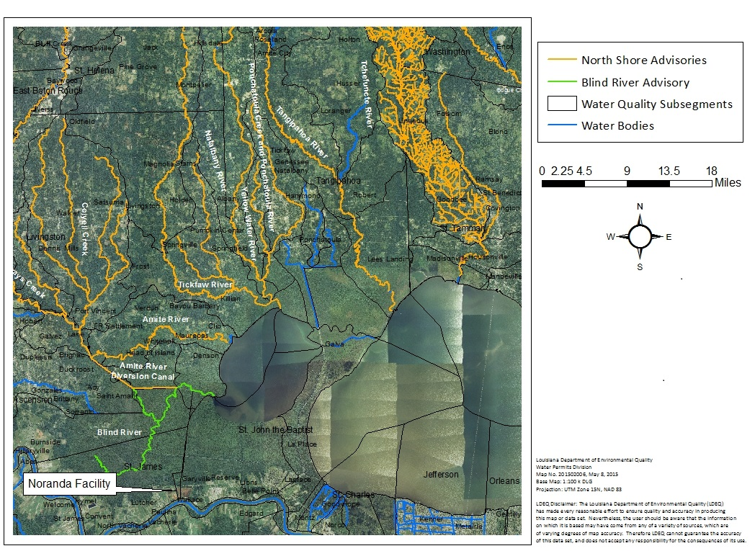
Blind River and Other Mercury Advisories in the Region

Slide 27
DEQ Mercury Information

Slide 28
Resources
U.S. Environmental Protection Agency (December 1997). Mercury Study Report to Congress Volume I: Executive Summary. Retrieved from US EPA website http://www.epa.gov/mercury/report.htm
U.S. Environmental Protection Agency (December 1997). Mercury Study Report to Congress Volume III: Fate and Transport of Mercury in the Environment. Retrieved from US EPA website http://www.epa.gov/mercury/report.htm
U.S. Environmental Protection Agency (December 1997) Mercury Study Report to Congress Volume V: Health Effects of Mercury and Mercury Compounds. Retrieved from US EPA website http://www.epa.gov/mercury/report.htm
Cohen, M. of the National Oceanic and Atmospheric Administration (NOAA) Air Resources Laboratory (2006). Atmospheric Mercury: Emissions, Transport/Fate, Source-Receptor Relationships [Presentation]. PowerPoint Presented at the Collaborative Meeting on Modeling Mercury in Freshwater Environments. Niagara Falls, NY.

Slide 29
Resources
University of Minnesota, Environmental & Occupational Health. Mercury: fate and transport-Environmental Health Sciences. Retrieved from University of Minnesota website http://enhs.umn.edu/current/5103_spring2003/mercury/mercfate.html
Louisiana Department of Environmental Quality. DEQ Mercury Initiative. Retrieved from http://www.deq.louisiana.gov/portal/PROGRAMS/MercuryInitiative.aspx
ATSDR. 1999. Public Health Statement Mercury CAS# 7439-97-6. http://www.atsdr.cdc.gov/ToxProfiles/tp46-c1-b.pdf

